Slide 1
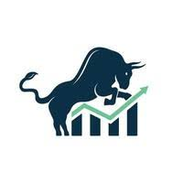
STOCKMARKET ANALYSIS
Presented by Group-5
Mr. Jitendra
Ms. Gayatri
Mr. Nirmit
Ms. Kavyasri
Mr. Nirmal
Mr.Arif

Slide 2
Introduction:
The stock market is a dynamic and complex system that serves as a cornerstone of the global economy. It is a marketplace where investors buy and sell shares of publicly traded companies, with prices fluctuating based on supply and demand dynamics, company performance, and broader economic indicators. Effective stock market analysis is essential for investors seeking to make informed decisions, minimize risks, and maximize returns.
Purpose of Stock Market Analysis:
The primary goal of stock market analysis is to evaluate and predict the future performance of stocks. This involves examining various factors such as historical price movements, financial statements, industry trends, and macroeconomic conditions. By understanding these elements, investors can identify potential investment opportunities, determine the appropriate times to buy or sell, and develop strategies that align with their financial goals.

Slide 3
KPI’s

Slide 4
KPI’S

Slide 5
Key metrics of KPI’s requirement
Total Market cap
220825024722235
High Market Shares
2275458462
Low Market Shares
4583123
Count of stock split
1697
Average Trading Volume
5494383

Slide 6
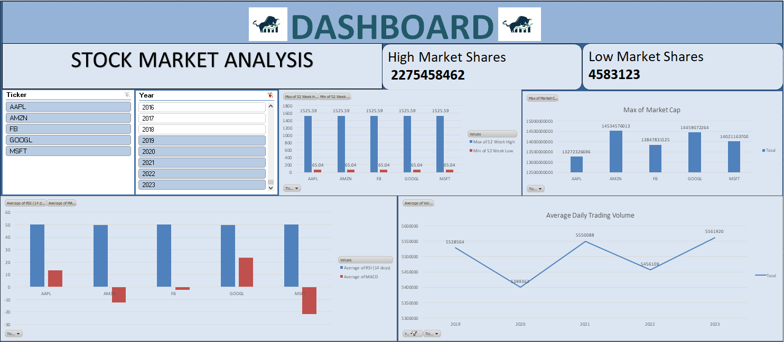
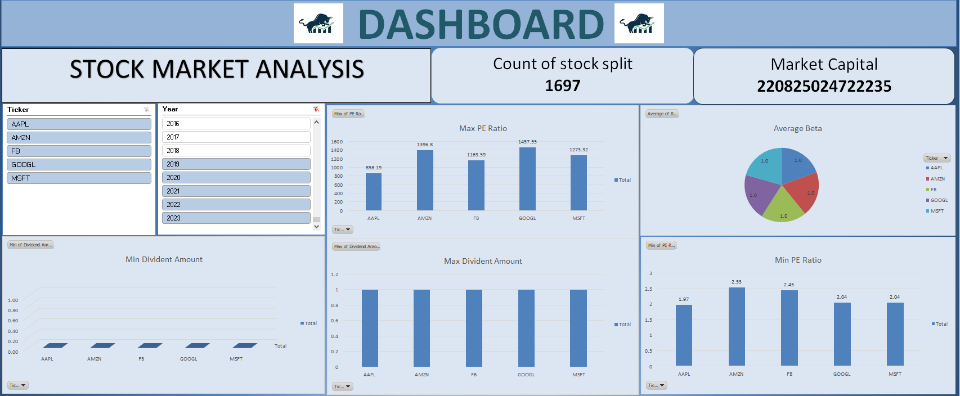
Dashboard using Excel

Slide 7
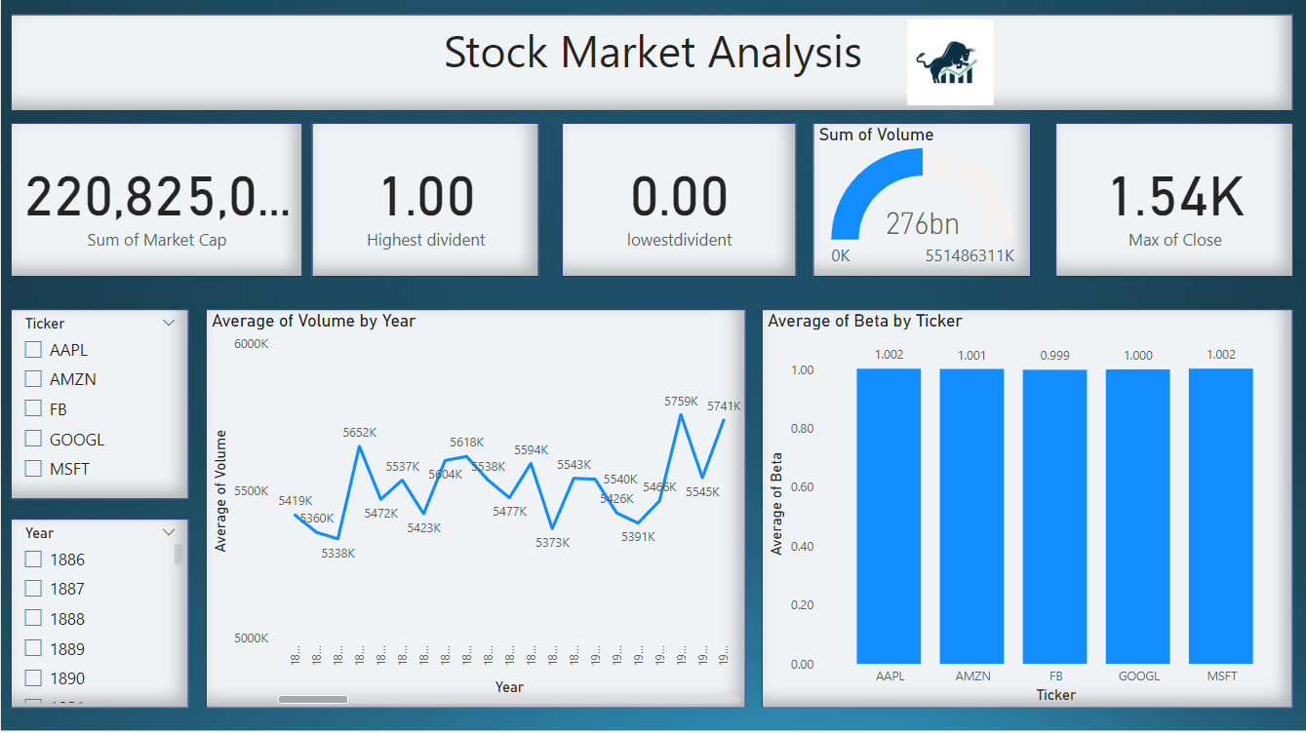
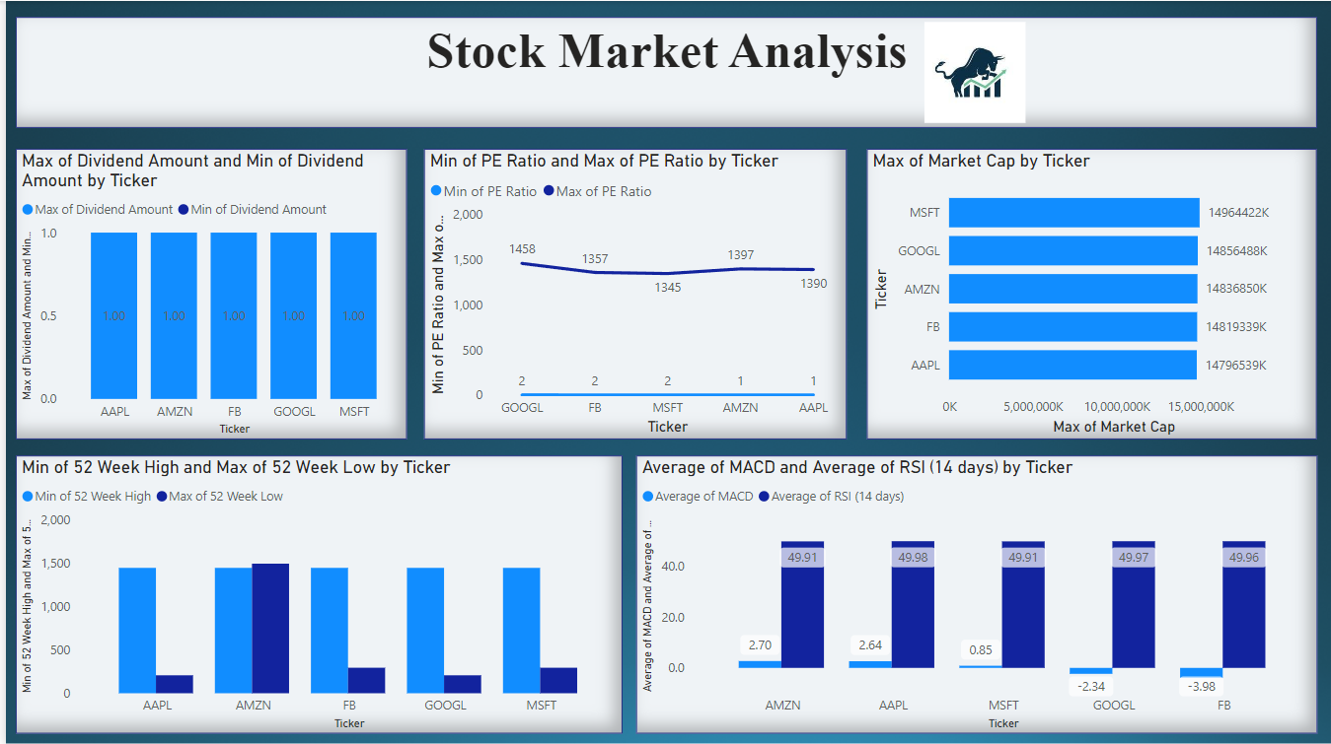
Dashboard using Power bi

Slide 8
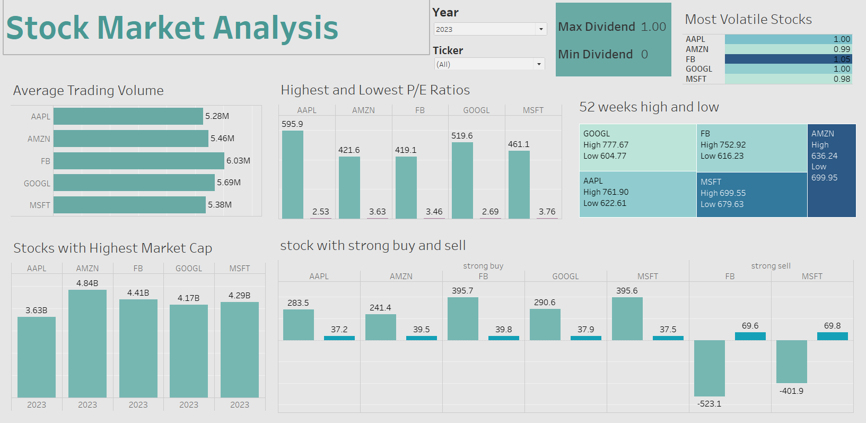
Dashboard using Tableau

Slide 9
Conclusion:
The conclusion for Stock market analysis based on specified KPI’s:
By finding Average daily trading volume we came to know that each company trading every year from 1896-2023.
Most volatile stocks is about that have higher price sensitivity to market movements to overall market index.
Stocks with highest market capital offers stability and liquidity of a company.
All this metrics are used for investors and traders to gauge a stocks performance and access its potential future movements.
Overall this Stock Market Analysis project combined SQL for data manipulation and Power BI, Excel, Tableau for visualization to create a comprehensive report. Traders and Investors can use these insights to make decisions regarding stocks of companies and can invest in them.

